Slide 1
HomophonesHomographs Homonyms
Pratibha Khandelwal
Assistant Professor
Department of Education
Durga Mahavidyalaya

Slide 2
Explain these Lines
One mourning, while weighting four the school bus, I felt a pane in my heal. It seams I had a whole inn my shoes and a peace of glass was cot inside.

Slide 3
Confused?

Slide 4
What I meant Was!
One morning, while waiting for the school bus, I felt a pain in my heel. It seems I had a hole in my shoes and a piece of glass was caught inside.

Slide 5
English is a very confusing language. Some words which make it confusing are:
Homophones
Homographs
Homonyms

Slide 6
Homophones
Homophones are the words that have the same pronunciation, but different spellings and different meanings.

Slide 7
Homophones (Examples)
Maid/Made
Principal/Principle
Waist/Waste
To/Too/Two
Knead/Need
Brake/Break

Slide 8
Can you work out the homophones using these tricky clues?
Two of a fruit
pair
pear

Slide 9
Not strong for seven days
Monday
Tuesday
Wednesday
Thursday
Friday
Saturday
Sunday
weak
week

Slide 10
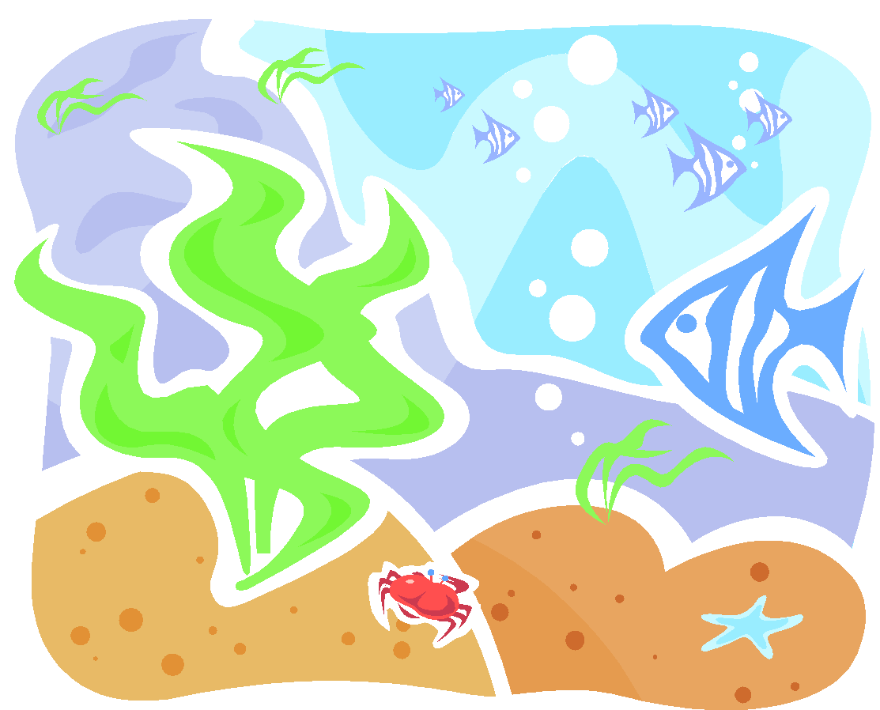
To look at the ocean
see
sea

Slide 11
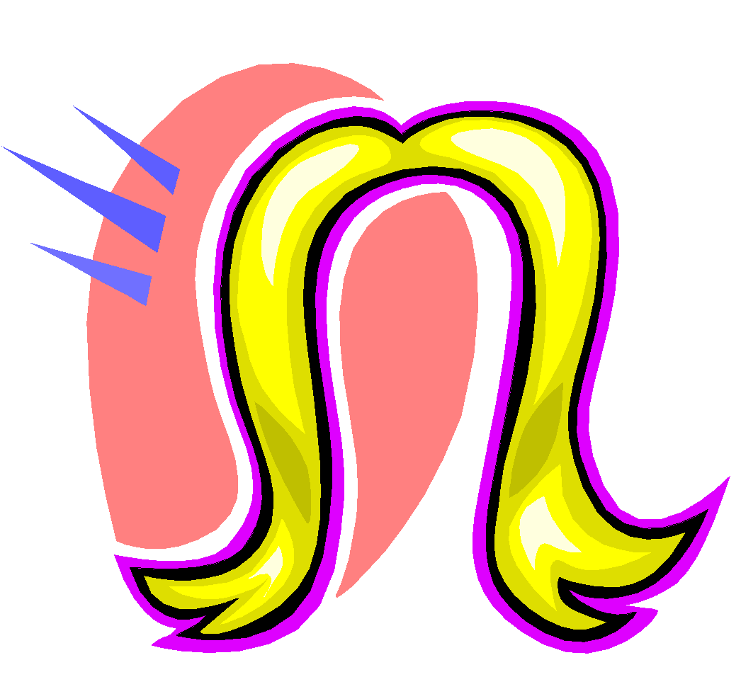
A type of animal that grows on your head
hare
hair

Slide 12
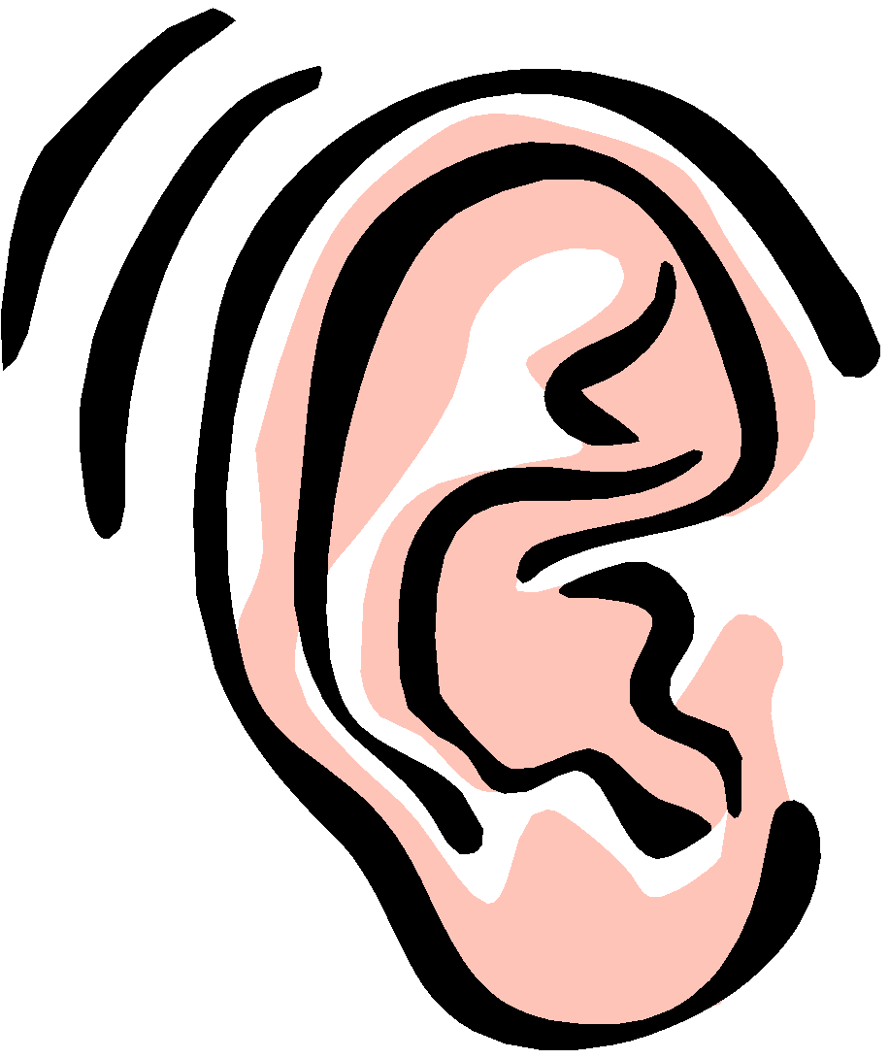
Not there to listen
here
hear

Slide 13
A baking ingredient in the garden
flour
flower

Slide 14
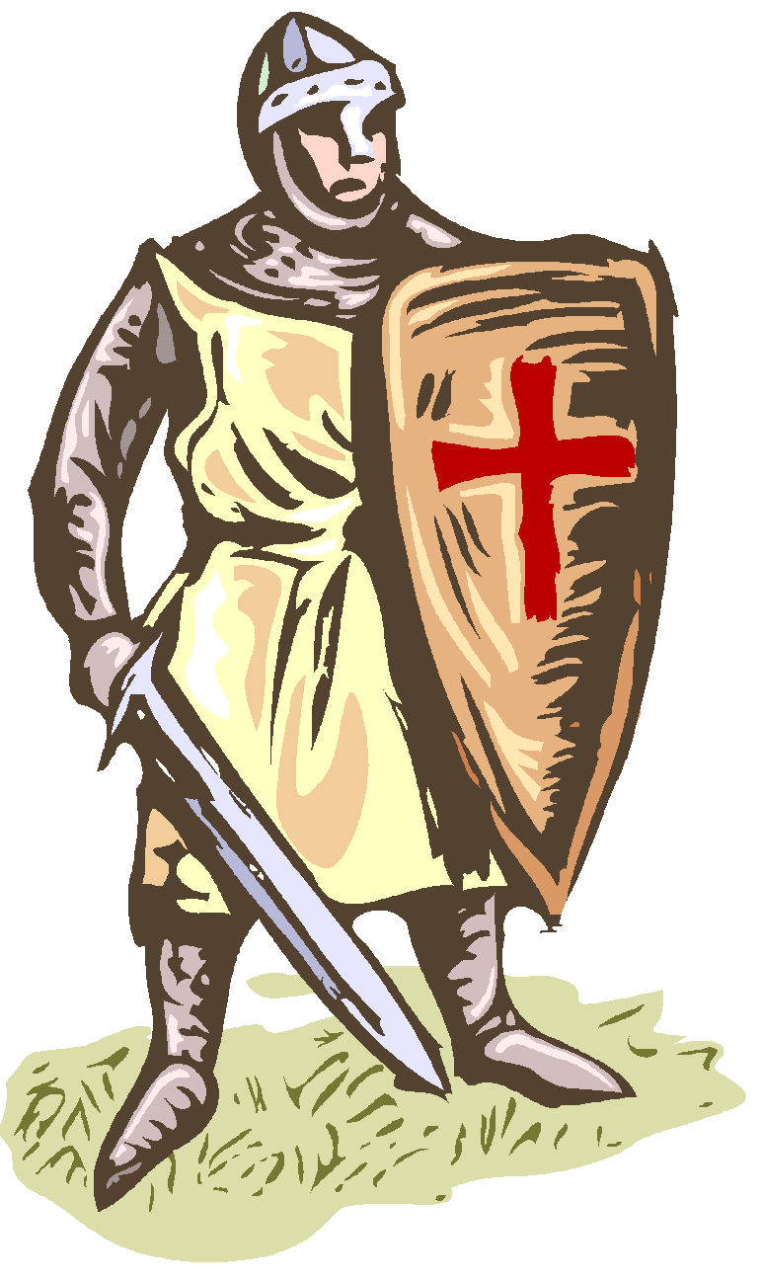
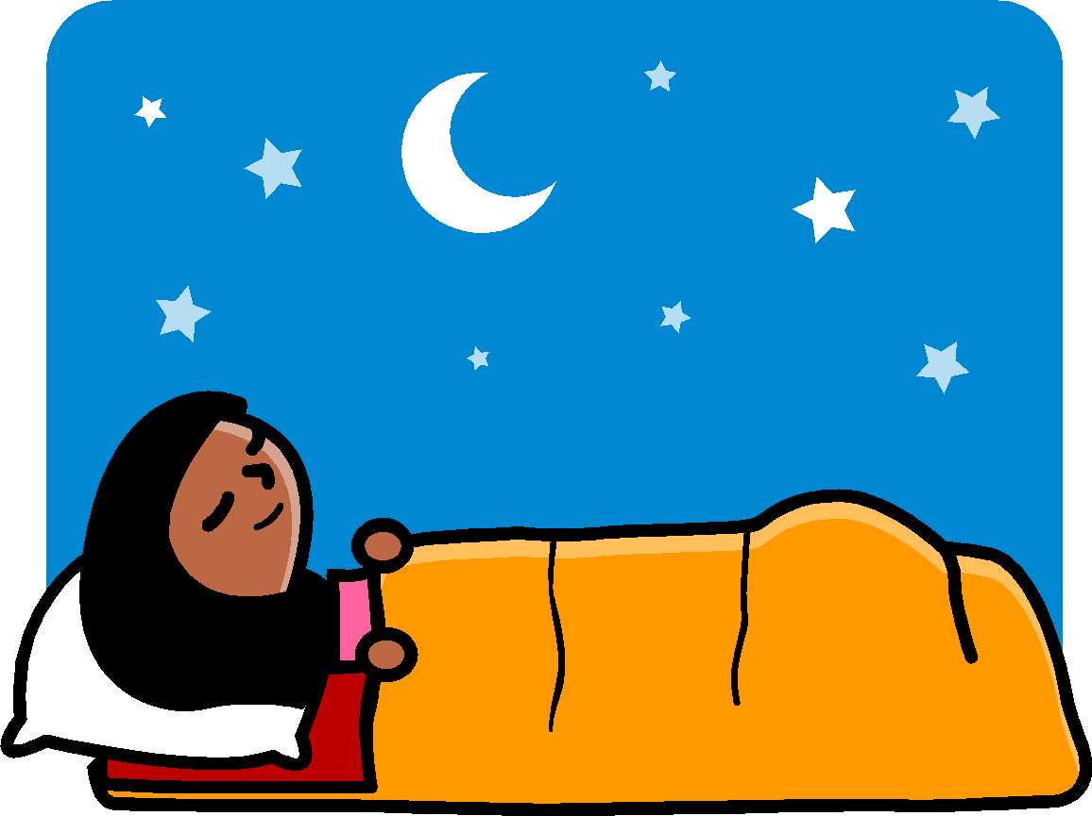
After dark in shining armour
night
knight

Slide 15
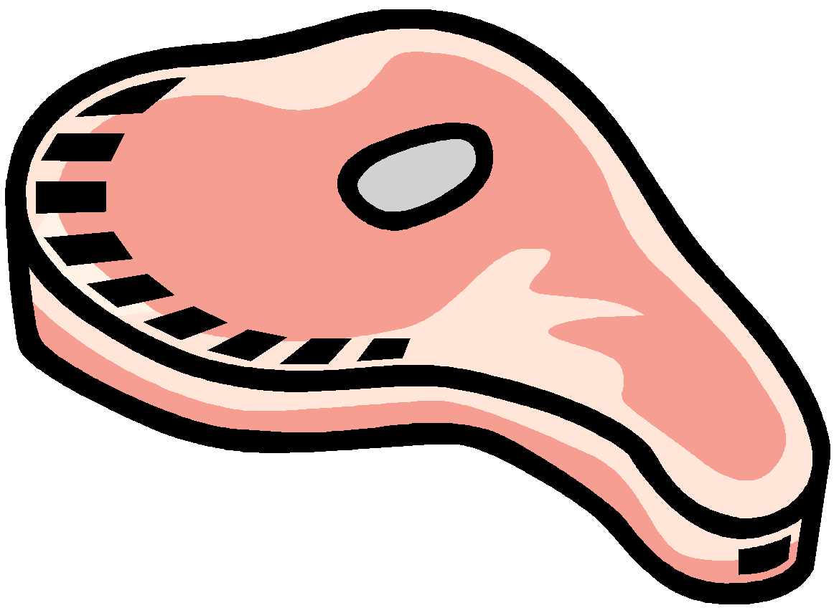
To encounter the beef
meet
meat

Slide 16
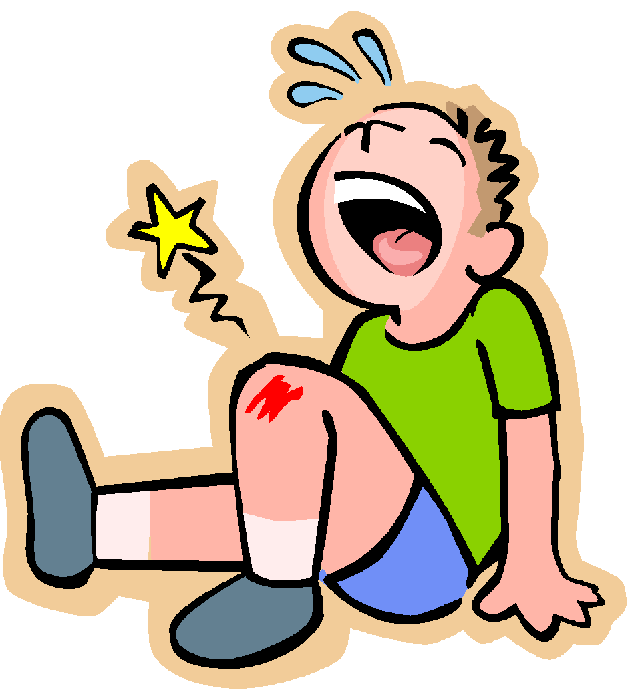
A painful tool
sore
saw

Slide 17
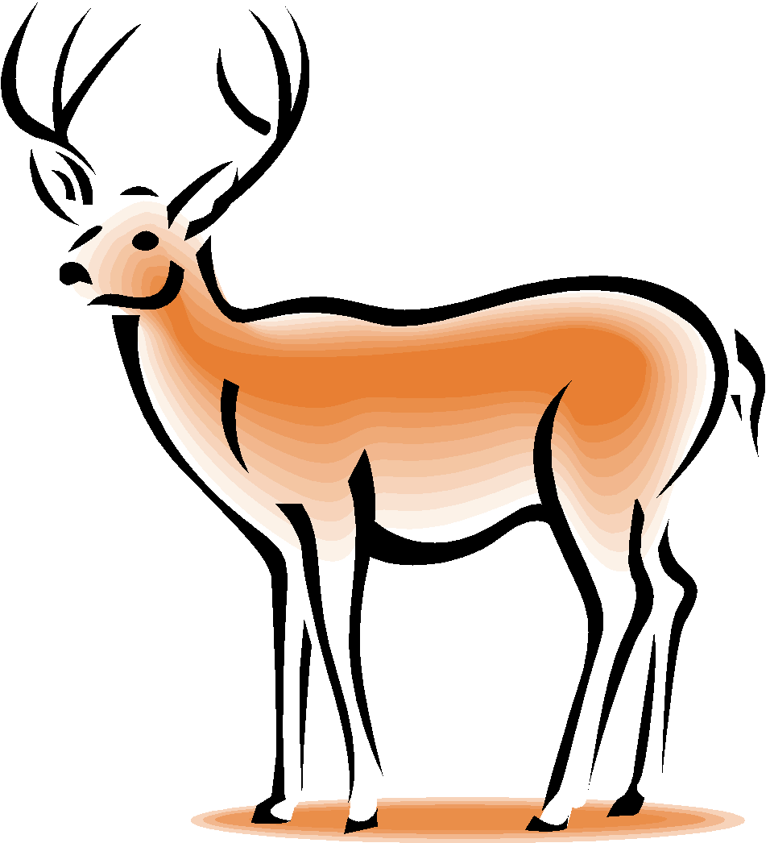
A beloved creature
dear
deer

Slide 18
To cry for a sea creature
wail
whale

Slide 19
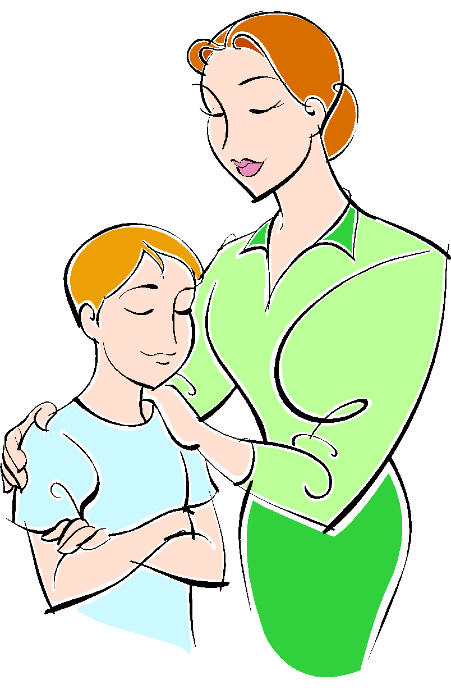
A boy the planets revolve around
son
sun

Slide 20
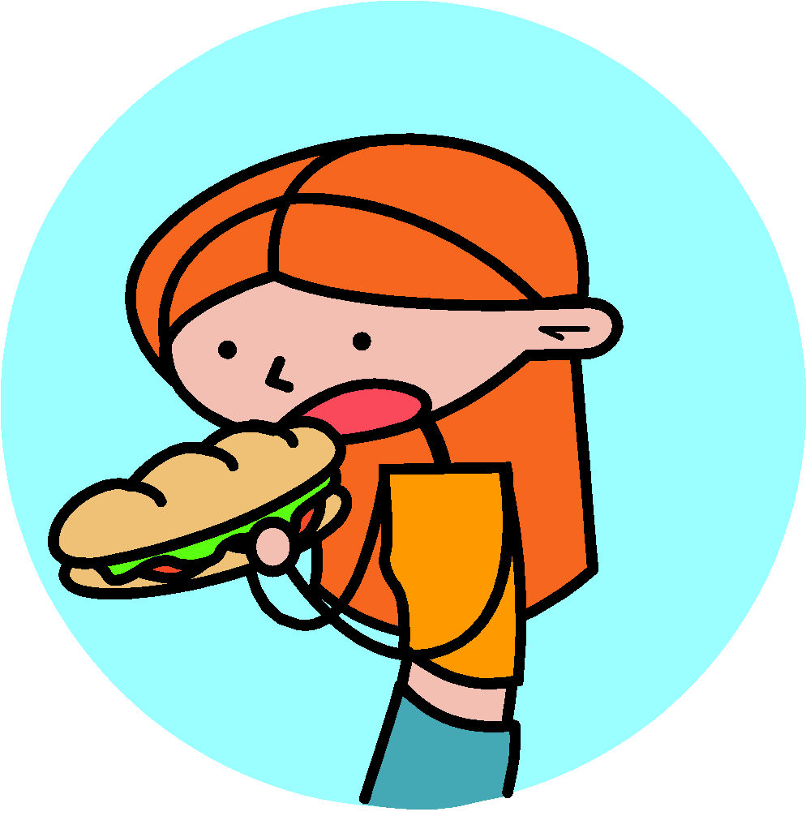
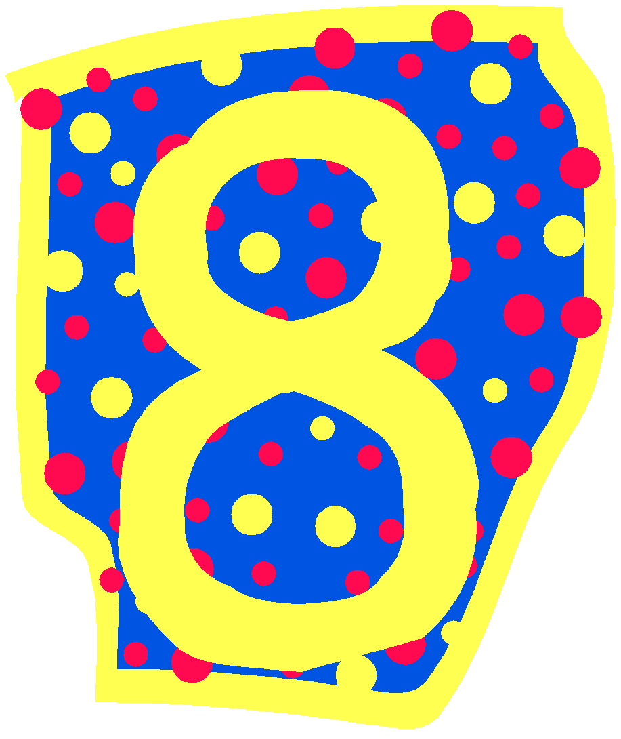
Swallowed the number
ate
eight

Slide 21
To find how heavy the path is
weigh
way

Slide 22
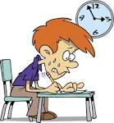
Testing Time

Slide 23
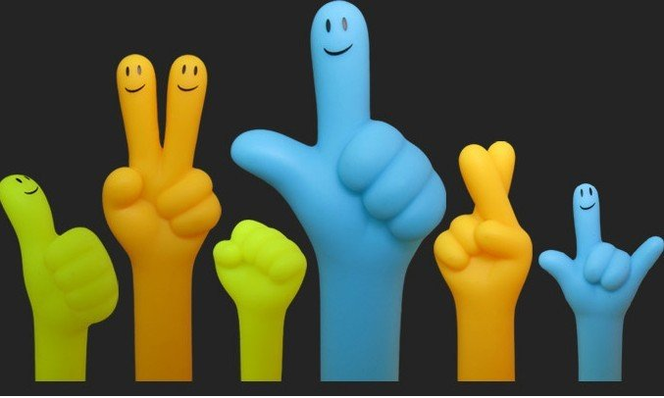
Result Time

Slide 24
Let’s see the Next Category

Slide 25
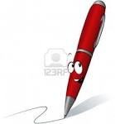
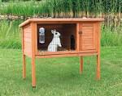
Identify the Picture
Pen
Pen

Slide 26
Bat
Bat

Slide 27
Spring
Spring

Slide 28
Watch
Watch

Slide 29
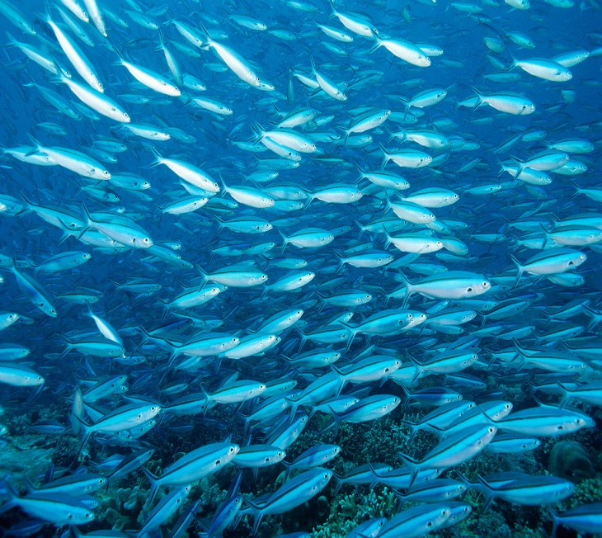
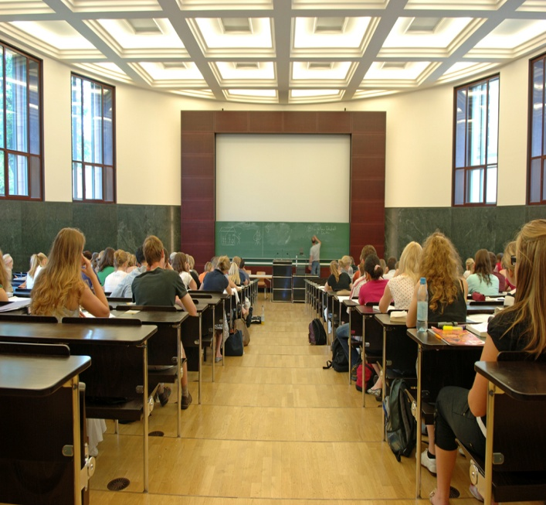
School
School

Slide 30
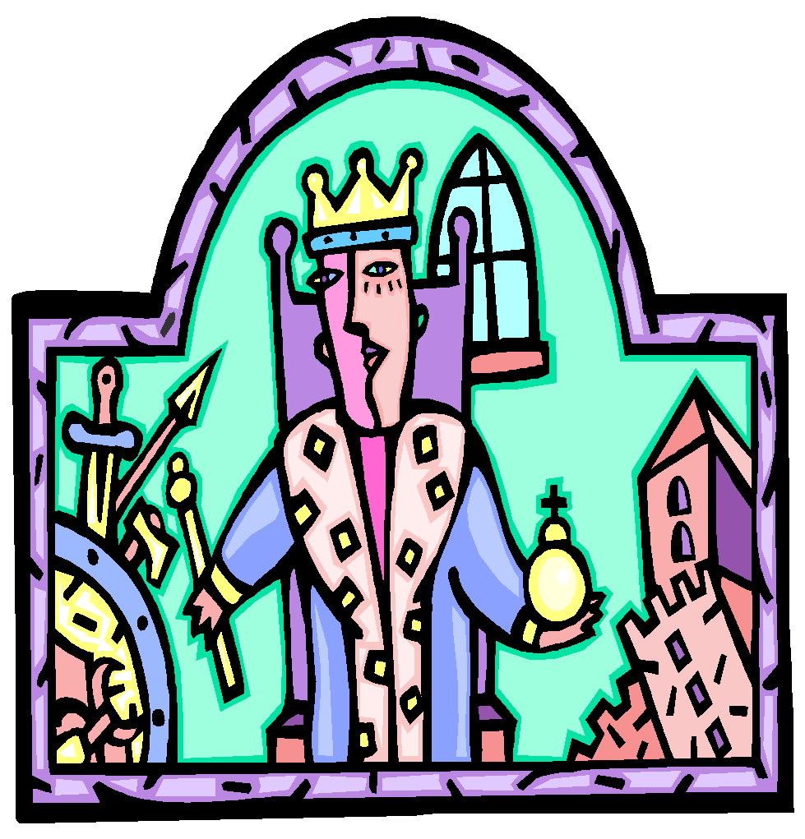
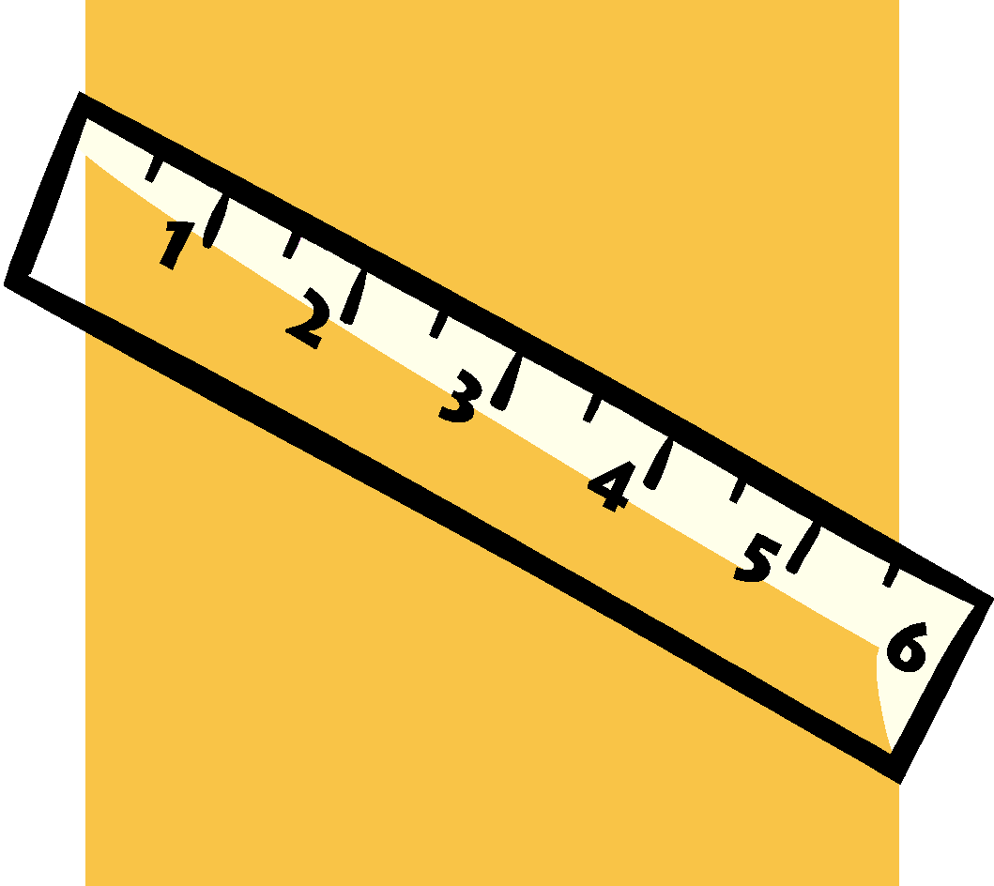
Ruler
Ruler

Slide 31
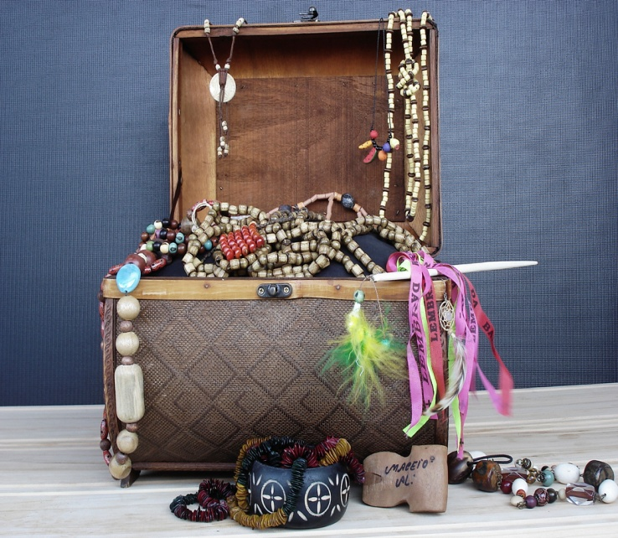
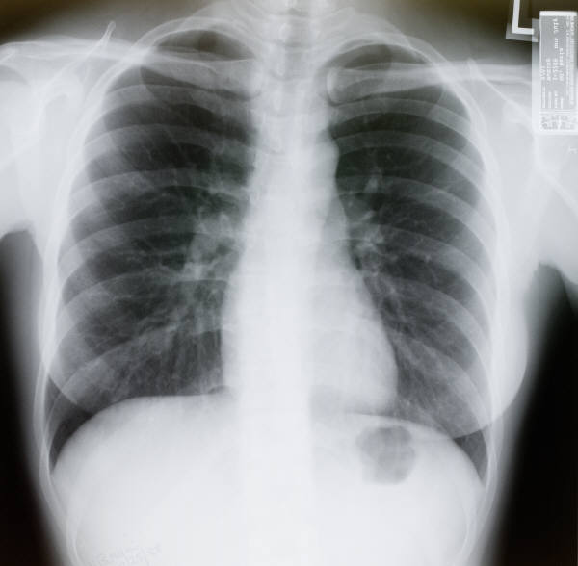
Chest
Chest

Slide 32
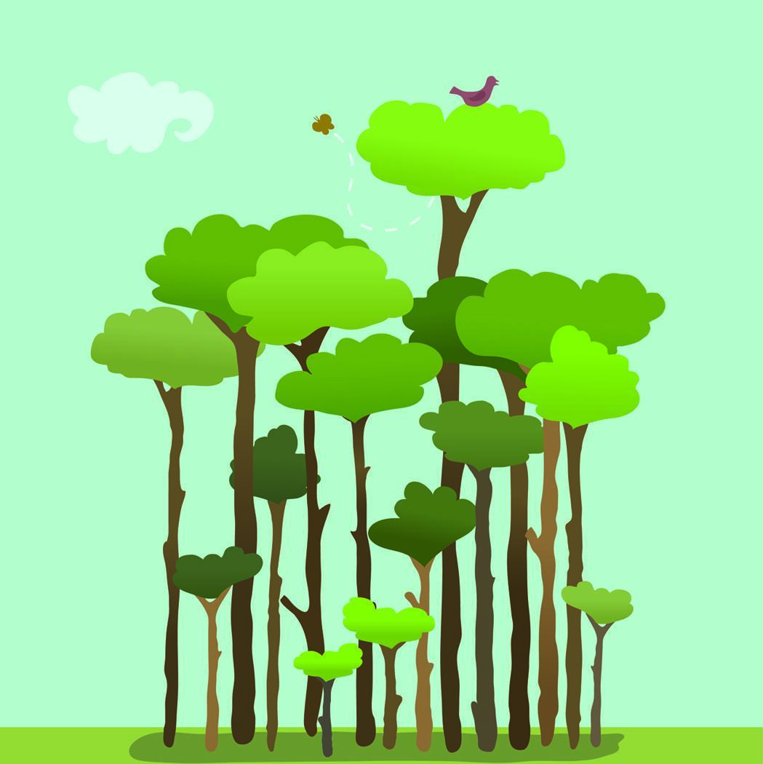
Top
Top

Slide 33
Homonyms
Homonyms are the words that have the same spelling and same pronunciation but different meanings.
Play/Play
Object/Object
Present/Present

Slide 34
Sentences with Homonyms
The oil well is yours and the gold mine is mine.
Don’t park the car near the park bench.
I never wear a watch when I watch TV.
The rose bushes rose out of the fertile ground.
Scale the fish, then weigh it on the scale.

Slide 35
Testing Time

Slide 36
Result Time

Slide 37
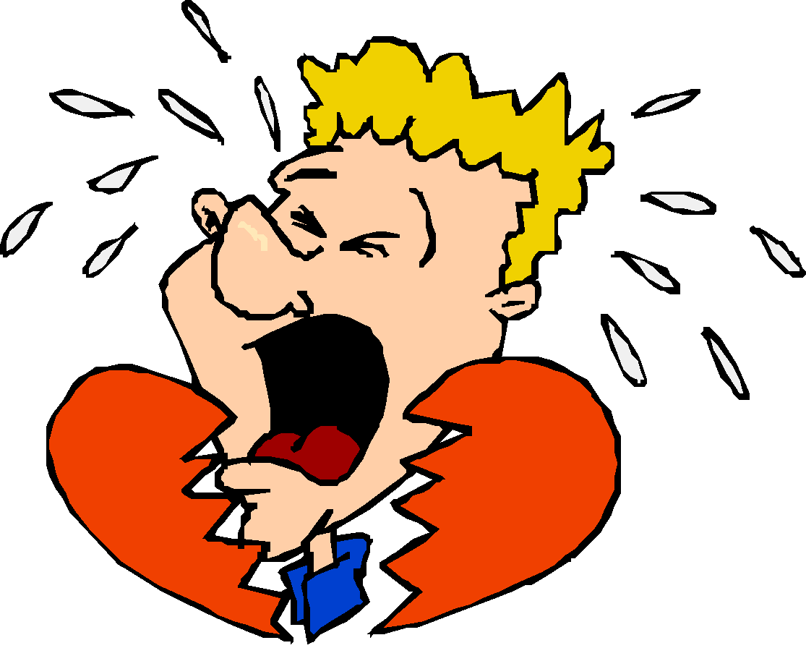
Identify the Picture
Tear
Tear

Slide 38
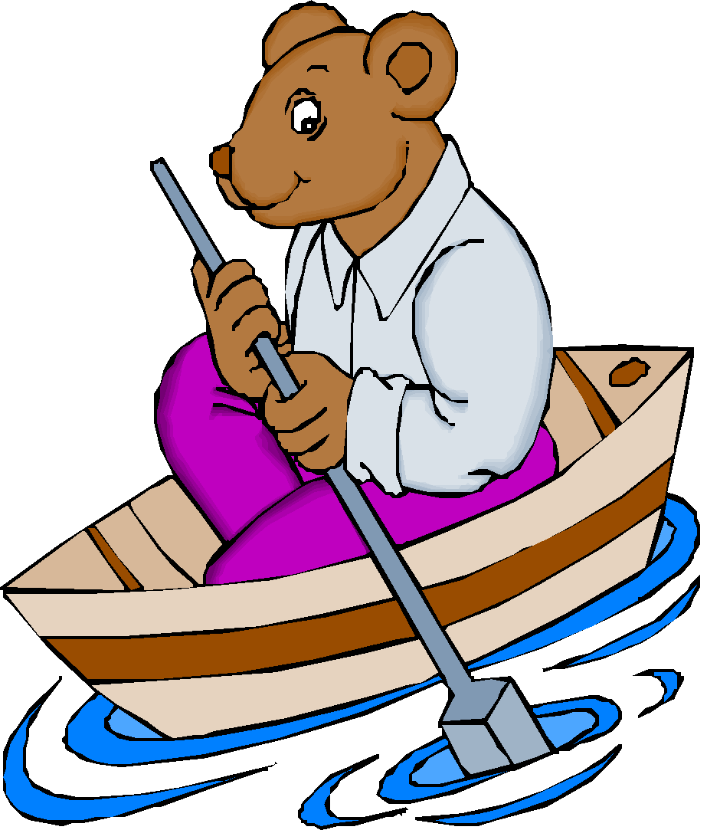
Identify the Picture
Row
Row

Slide 39
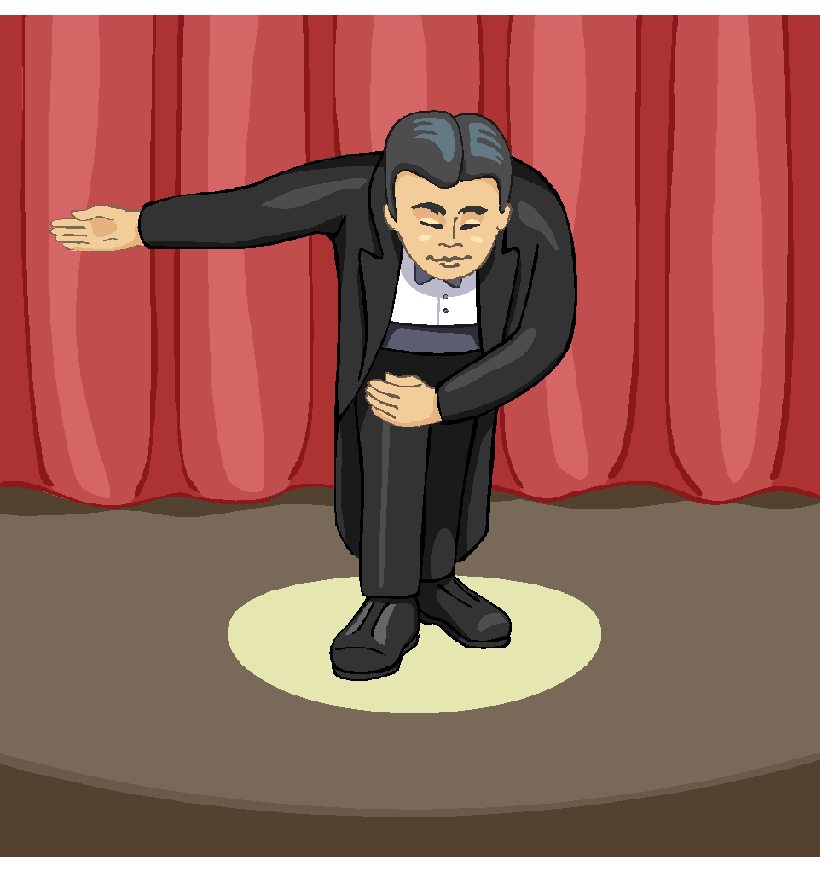
Bow
Bow

Slide 40
Homographs
Homographs are the words that have the same spelling but different pronunciation and meanings.
Live/Live
Lead/Lead
Minute/Minute

Slide 41
Testing Time

Slide 42
Thank You

